Slide 1
Python 2.7 vs Python 3

Slide 2
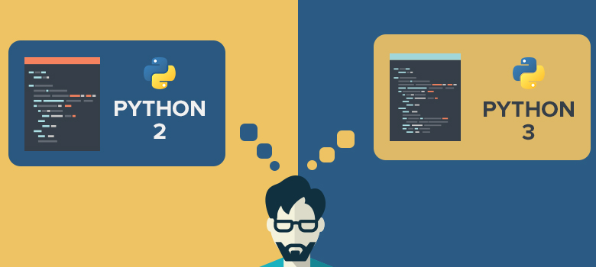
“Python 2.x is legacy, Python 3.x is the present and future of the language.”
wiki.python.org

Slide 3
Python 2.7 vs Python 3

Slide 4
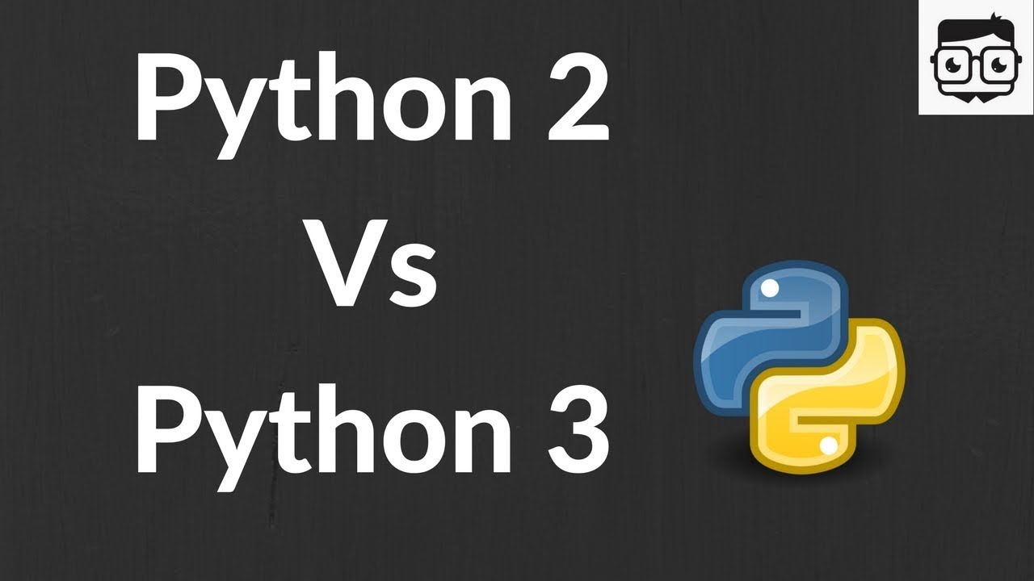
End of Life for Python 2.x
However, Python 2 is slated to lose all support in 2020, is still popular but it’s definitely going to end. There’s not going to be any Python 2.8.
Python 3, despite it’s slow adoption and early problems with Unicode, is now a strong version of the language.

Slide 5
3rd Party Library Support for Python 2.x
One of the great strengths of Python 2 is the long tail of 3rd party libraries to do, well, just about anything.
Python 3 doesn’t have this. Yes, a lot of libraries have been ported, but ten times as many have not, and are not trivial to port.

Slide 6
Advantage claimed with Python 3.x
The main advantage of 3.x is that it is on the cutting edge, so all the new features will be implemented in there rather than being added to 2.x.
The other thing you may want to consider is that it is the common python of the future, so looking a couple of years down the line, this will be the mature branch that people go to.

Slide 7
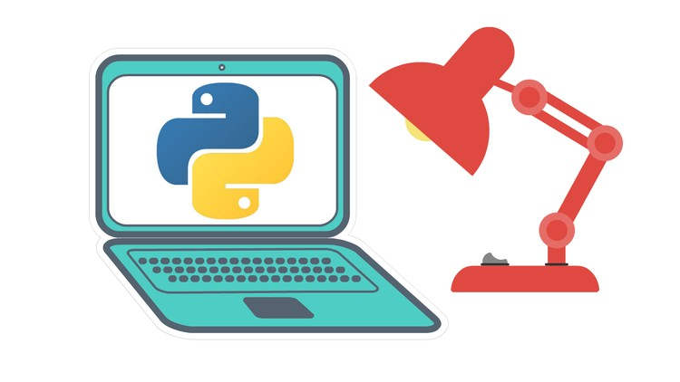
List of Key Changes
A non-exhaustive list of features which are only available in 3.x releases and won't be backported to the 2.x series:
strings are Unicode by default
clean Unicode/bytes separation
exception chaining
function annotations
syntax for keyword-only arguments
extended tuple unpacking
non-local variable declarations

Slide 8
Technical Differences

Slide 9
Several aspects of the core language (such as print and exec being statements, integers using floor division) have been adjusted to be easier for newcomers to learn and to be more consistent with the rest of the language

Slide 10
The “Print” Dilemma
Wiki.python.org goes into depth on the differences between Python 2.7 and 3.3, saying that there are benefits to each.
For example:
In Python 2, “print” is treated as a statement and in Python 3 explicitly treats “print” as a function, which means you have to pass the items you need to print to the function in parentheses in the standard way, or you will get a syntax error. A statement rather than a function.

Slide 11
Unicode Strings
Python 3 stores strings as Unicode by default, whereas Python 2 requires you to mark a string with a “u” if you want to store it as Unicode.
Unicode strings are more versatile than ASCII strings, which are the Python 2 default, as they can store letters from foreign languages as well as emoji and the standard Roman letters and numerals.

Slide 12
input() is Now Safe to Use
In Python 2, there was a raw_input() function and an input() function.
raw_input() was the one you always wanted to use. input() was a great way to have your code do things you didn’t want it to. The reason for this is that input() evaluated whatever came in.
In Python 3, raw_input() is gone and input() no longer evaluates the data it receives. You always get back a string.

Slide 13
Python 2 vs. Python 3: Summary

Slide 14
Key Differences
Key issues that may require you to use Python 2 rather than Python 3:
Firstly, if you are deploying to an environment you don't control, that may require use of a specific version, rather than allowing you a free selection from the available versions.

Slide 15
Key Differences
Key issues that may require you to use Python 2 rather than Python 3:
Secondly, if you want to use a specific third party package or utility that doesn't yet have a released version that is compatible with Python 3, and porting that package is a non-trivial task, you may choose to use Python 2 in order to retain access to that package.
Now, every major external python package has been updated to support Python 3!

Slide 16
Key Differences
However, it is a good idea to be aware that there are material differences between Python 2 and Python 3 in case you ever need to deal with code that is written in the version of the language with which you are less familiar.

Slide 17
Bottomline
It is important to keep in mind:
As more developer and community attention focuses on Python 3, the language will become more refined and in-line with the evolving needs of programmers, and less support will be given to Python 2.7.
For now, it is recommended to focus on writing good code so that 2.x vs 3.x becomes less of an issue. That includes writing full unit test suites, and getting Unicode right.

Slide 18
END

